Slide 1





GREEN UNIVERSITY OF BANGLADESH
Department of CSE
Course: Machine Learning Lab
Presentation on
Sentiment WhatsApp Chat Analyzer
Course Instructor
Md. Atikuzzaman
Assistant Professor
Green University Of Bangladesh
1

Slide 2

Presented By
1
Ahshanul Haquc
213002122
2
Sabbir Mahmud Tanvir
213002074
2

Slide 3
Table of Content
1
Introduction
2
Motivation
3
Problem Statement
4
Objectives
5
Tools & Technology Used
6
Working Procedure
7
Example Breakdown
3

Slide 4
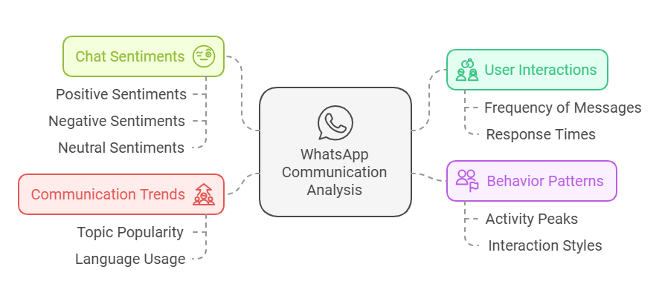
Introduction
“Analyzing WhatsApp chat data to find useful patterns, create easy-to-understand visuals, and perform sentiment analysis using Machine Learning.”
4

Slide 5
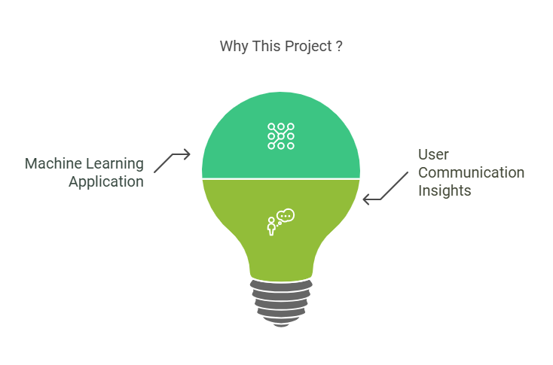
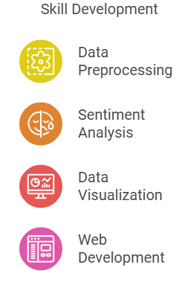
Motivation
5

Slide 6



Problem Statement
Users cannot easily analyze their WhatsApp chat history for:
Insights into chat frequency and interaction trends.
Common topics or sentiments within conversations.
A WhatsApp Chat Analyzer that provides:
Detailed chat statistics and patterns.
Sentiment classification (Positive, Negative, Neutral).
Easy-to-understand visualizations.
6

Slide 7
Objectives
Parse WhatsApp chat data and preprocess it for analysis.
Generate insights such as message count, word count, media shared, links shared, and emoji usage.
Perform sentiment analysis to classify messages into Positive, Negative, or Neutral.
Allow filtering by individual participants.
7

Slide 8
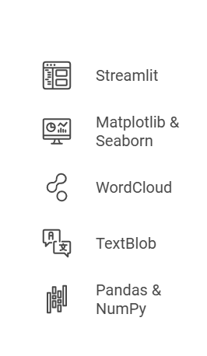
Tools & Technology
Programming Languages:
Python
Libraries and Frameworks:
Machine Learning:
TextBlob: Natural Language Processing.
For building the interactive web application.
For data visualization (charts, heatmaps, etc.).
For generating word clouds.
For performing sentiment analysis.
For data preprocessing and analysis.
8

Slide 9
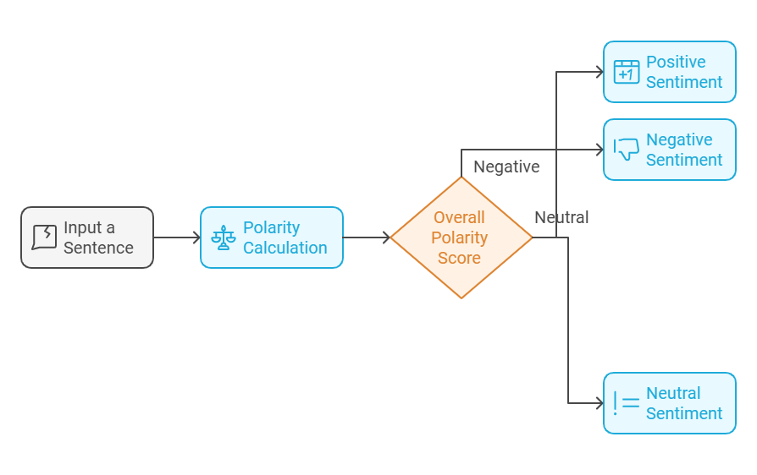
Working Procedure
"Good" → Positive polarity (+0.7)
"Bad" → Negative polarity (-0.6)
"Okay" → Neutral polarity (0.0)
Positive: Polarity > 0
Negative: Polarity < 0
Neutral: Polarity = 0
9

Slide 10
Example Breakdown
"The food was great, but the service was bad.“
Tokenization (Breaking into Words):
Split the sentence into words: ["The", "food", "was", "great", "but", "the", "service", "was", "bad"]
Polarity Assignment:
"Great" → Polarity = +0.8
"Bad" → Polarity = -0.6
Other words like "The", "was", "but" → Neutral (Polarity = 0.0)
Polarity Calculation:
Overall Polarity = (Sum of word polarities) / (Number of words with polarity) = (+0.8 + (-0.6)) / 2 = +0.2 (Positive)
Classification:
Polarity = +0.2 → Positive sentiment.
10

Slide 11



THANKS
Do you have any questions?
11

